Slide 1

AME532a Group Presentation
ASW28 Model Controller Design and Simulation
Sen Yang()
Jiaoran Wang (625909903)
04/30/2020

Slide 2
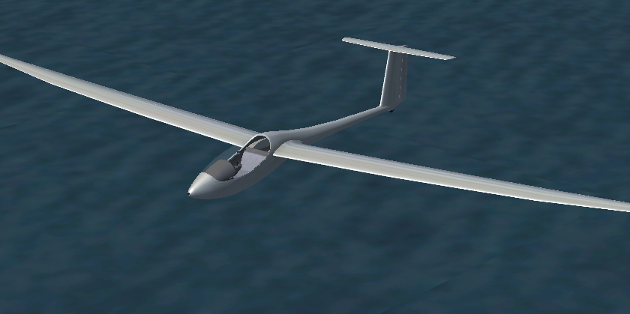
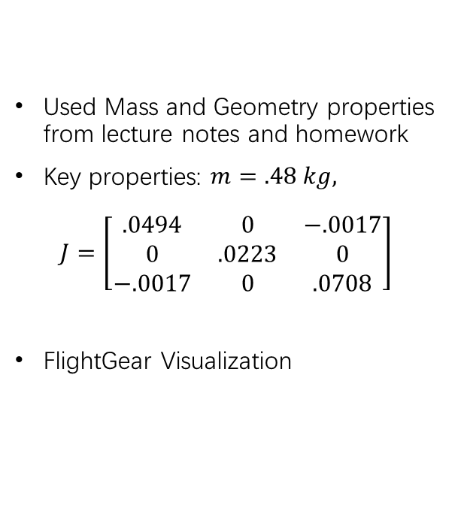
ASW-28 Aircraft
Used Mass and Geometry properties from lecture notes and homework
Key properties: $m=.48 kg,$ $J=\left[\begin{matrix}.0494 & 0 & −.0017 \\ 0 & .0223 & 0 \\ −.0017 & 0 & .0708\end{matrix}\right]$
FlightGear Visualization

Slide 3
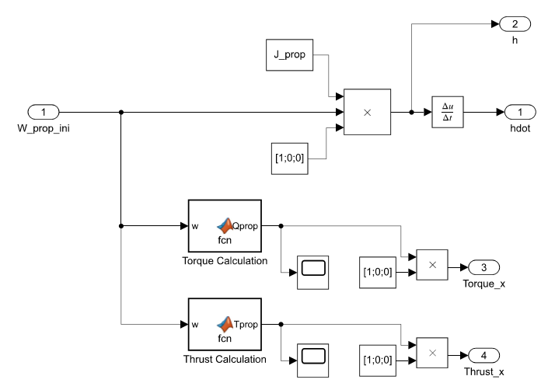
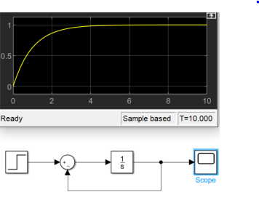
Nonlinear Dynamics Simulation
Block Diagram:
1st order actuator model
Simple Propeller Model:

Slide 4
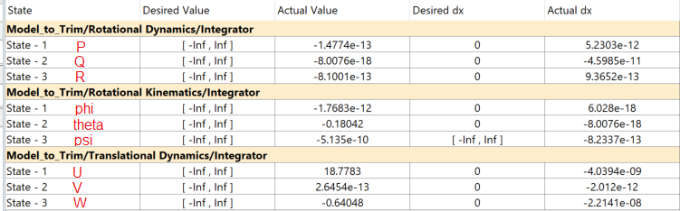
Trim & Linearization
Trim Results (Trans Kin, Propeller, 1st order actuators commented out):
Trim Condition (Glider) FlightGear Demonstration:
https://www.youtube.com/watch?v=aavscQ1y04M

Slide 5
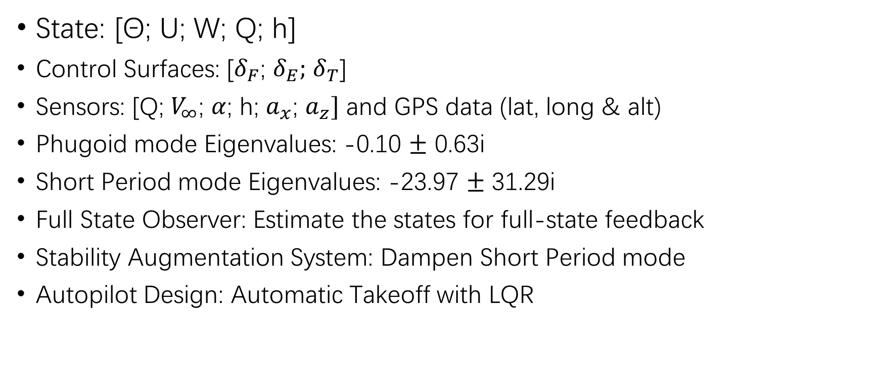
Longitudinal Mode
State: [Θ; U; W; Q; h]
Control Surfaces: [$δ_{F}$; $δ_{E};$ $δ_{T}$]
Sensors: [Q; $V_{∞}$; $α$; h; $a_{x}$; $a_{z}]$ and GPS data (lat, long & alt)
Phugoid mode Eigenvalues: -0.10 $±$ 0.63i
Short Period mode Eigenvalues: -23.97 $±$ 31.29i
Full State Observer: Estimate the states for full-state feedback
Stability Augmentation System: Dampen Short Period mode
Autopilot Design: Automatic Takeoff with LQR

Slide 6
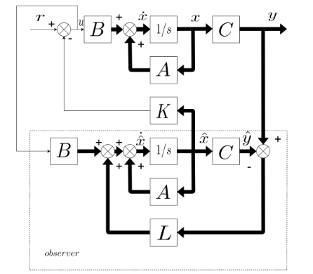
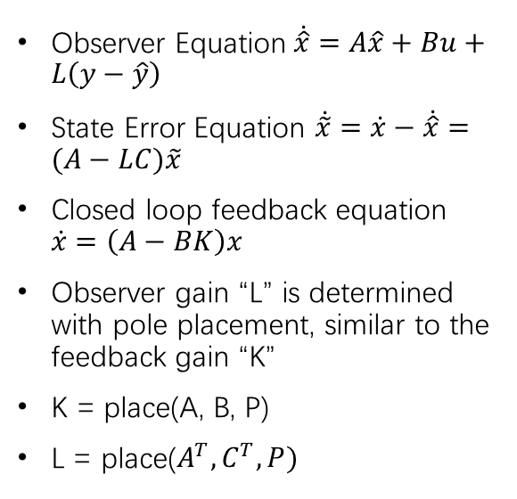
Full-State Observer
Observer Equation$\dot{\hat{x}}=A\hat{x}+Bu+L\left(y−\hat{y}\right)$
State Error Equation $\dot{\tilde{x}}=\dot{x}−\dot{\hat{x}}=(A−LC)\tilde{x}$
Closed loop feedback equation $\dot{x}=\left(A−BK\right)x$
Observer gain “L” is determined with pole placement, similar to the feedback gain “K”
K = place(A, B, P)
L = place($A^{T},C^{T},P)$

Slide 7
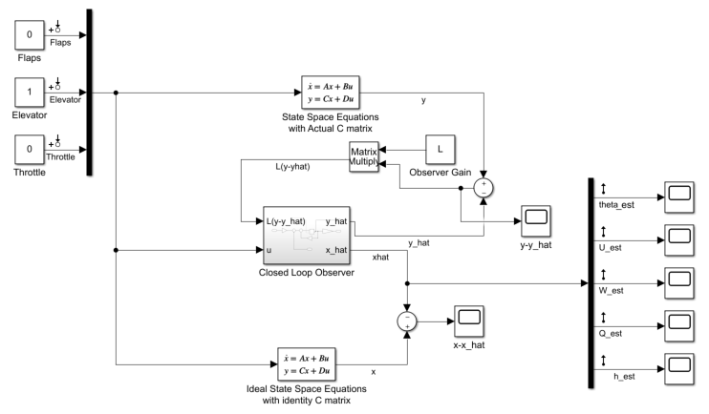
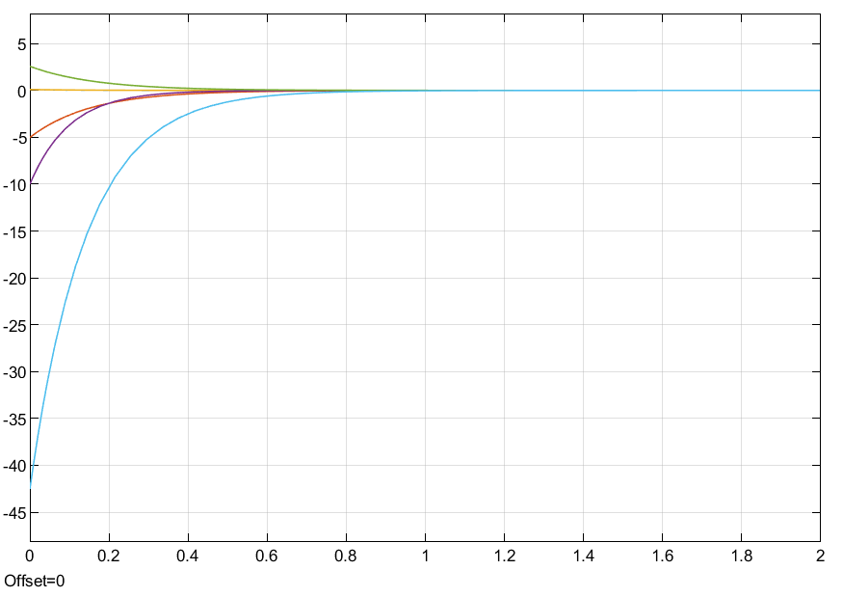
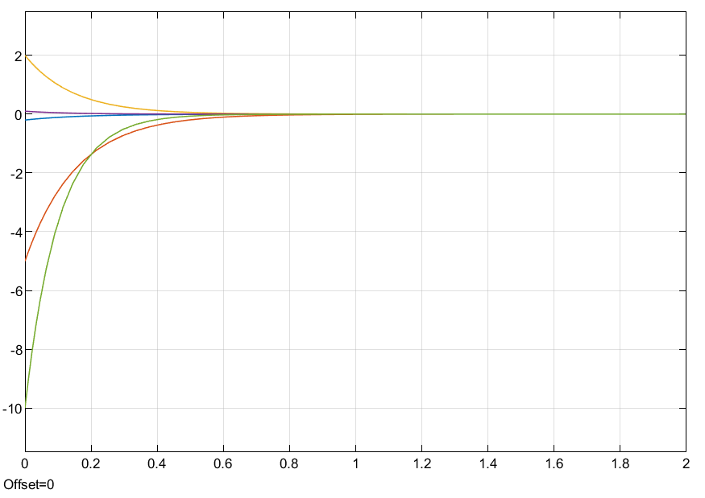


Full-State Observer
P=[-6 -6.5 -7 -7.5 -10]
“Actual” States initial conditions: [0; 0; 0; 0; 0]
“Observer” States initial conditions: [.2; 5; -2; -1; 10]
Error converges to 0 in less than 1 second
Linearized State Space System with Full-State Observer:
$$y −\dot{y}$$
$$x −\dot{x}$$

Slide 8
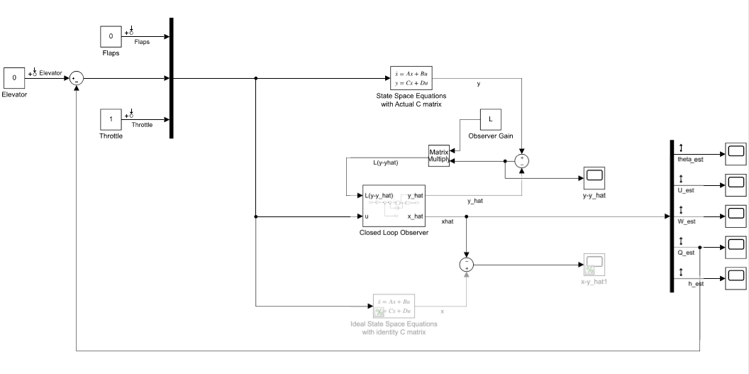

Pure Rate Feedback SAS
Goal of the SAS system is to dampen short period, as the initial response is fast and oscillatory with poles at -23.97 ± 31.29i
Short Period Mode is most related with Pitch rate Q to Elevator input
Pure Rate Feedback Block Diagram:
Open loop eigenvalue: -23.97 ± 31.29i $ω_{n}$ = 39.42 rad/s $ƺ$ = .61 $τ$ = .0417 s
Closed loop eigenvalue: -34.00 ± 0.00i $ω_{n}$ = 34.00 rad/s $ƺ$ = 1 $τ$ = .0294 s

Slide 9
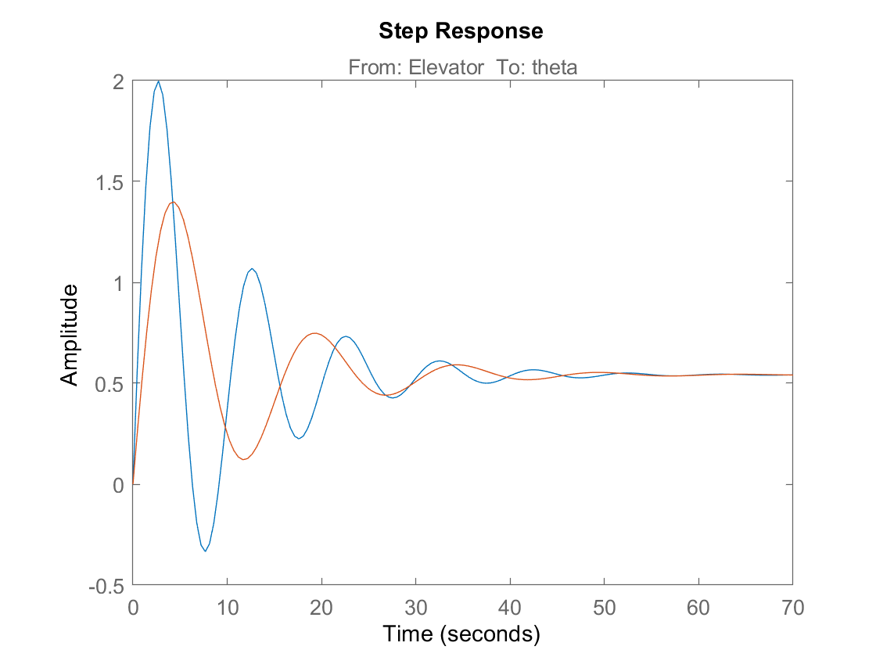
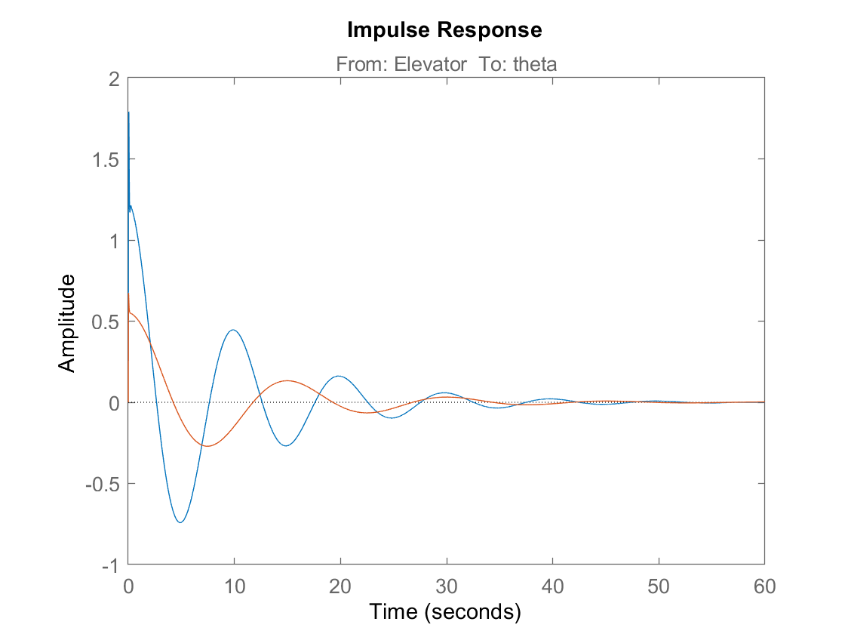
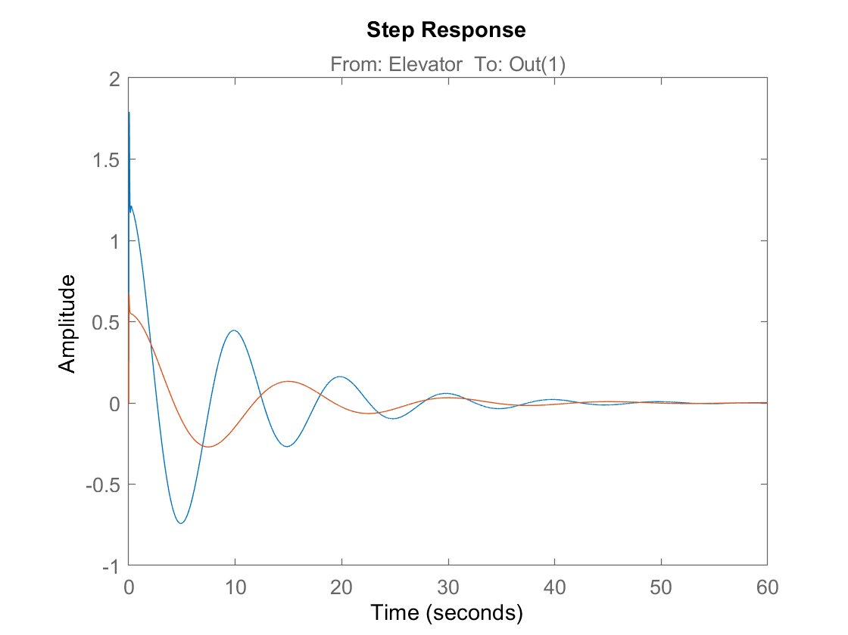
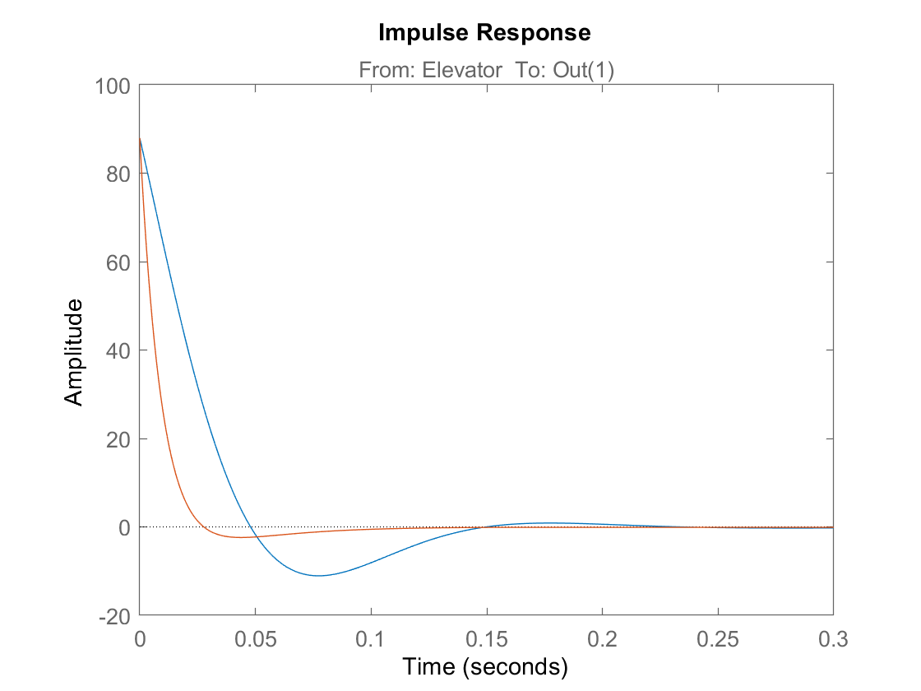
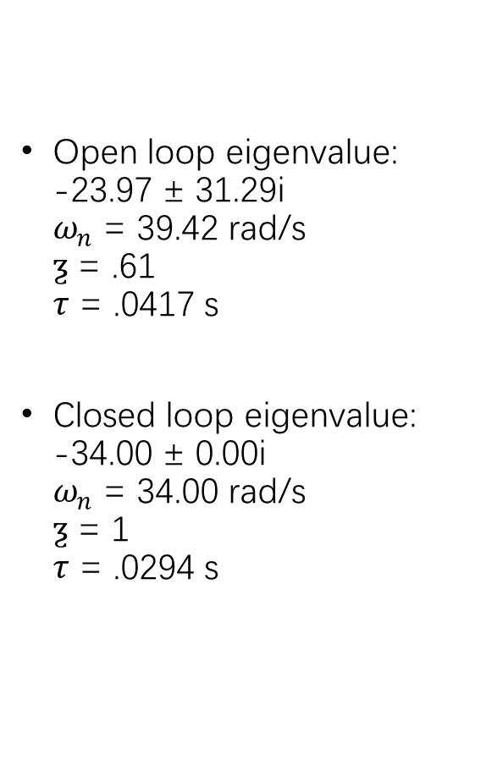
Pure Rate Feedback SAS
Open loop eigenvalue: -23.97 ± 31.29i $ω_{n}$ = 39.42 rad/s $ƺ$ = .61 $τ$ = .0417 s
Closed loop eigenvalue: -34.00 ± 0.00i $ω_{n}$ = 34.00 rad/s $ƺ$ = 1 $τ$ = .0294 s

Slide 10
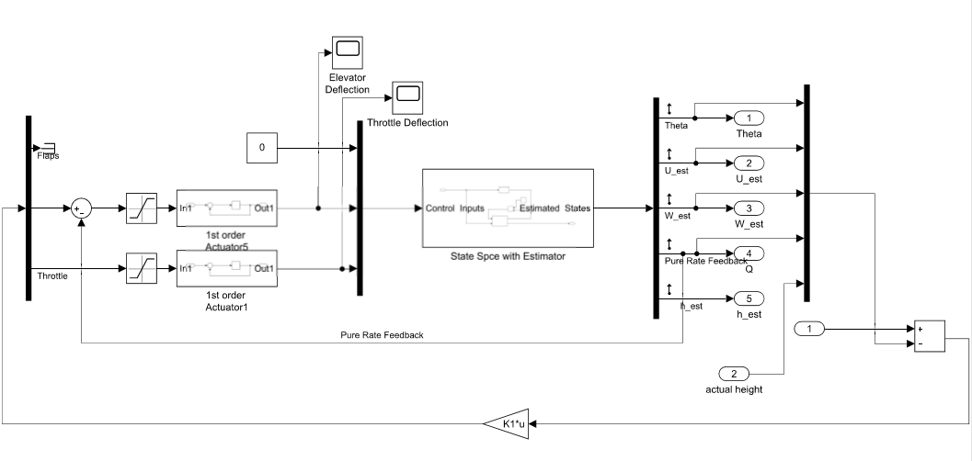
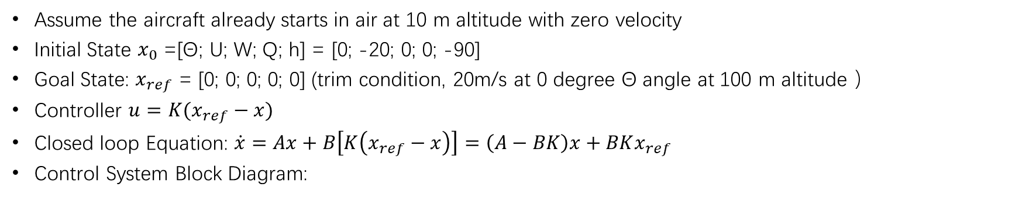
Automatic Takeoff with LQR
Assume the aircraft already starts in air at 10 m altitude with zero velocity
Initial State $x_{0}$ =[Θ; U; W; Q; h] = [0; -20; 0; 0; -90]
Goal State: $x_{ref}$ = [0; 0; 0; 0; 0] (trim condition, 20m/s at 0 degree Θ angle at 100 m altitude ）
Controller $u=K(x_{ref}−x)$
Closed loop Equation: $\dot{x}=Ax+B\left[K\left(x_{ref}−x\right)\right]=\left(A−BK\right)x+BKx_{ref}$
Control System Block Diagram:

Slide 11
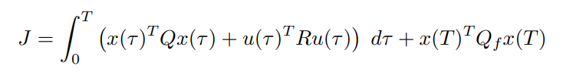
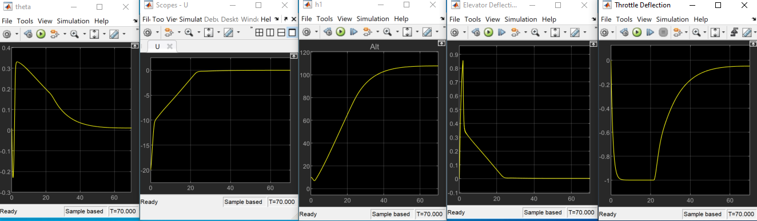
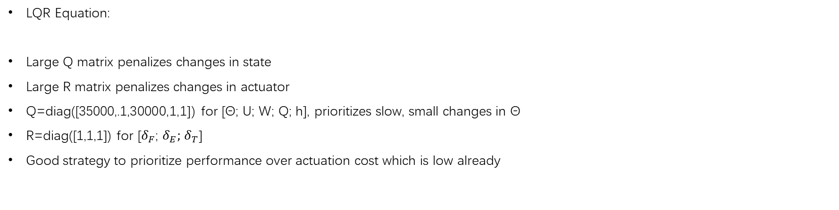
Automatic Takeoff with LQR
LQR Equation:
Large Q matrix penalizes changes in state
Large R matrix penalizes changes in actuator
Q=diag([35000,.1,30000,1,1]) for [Θ; U; W; Q; h], prioritizes slow, small changes in Θ
R=diag([1,1,1]) for [$δ_{F}$; $δ_{E};$ $δ_{T}$]
Good strategy to prioritize performance over actuation cost which is low already

Slide 12
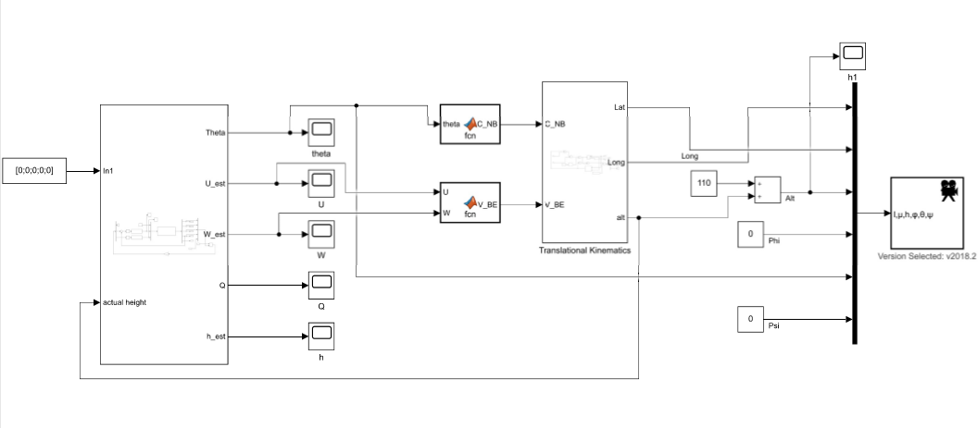
Automatic Takeoff with LQR
Top level block diagram with FlightGear
FlightGear Demonstration: https://www.youtube.com/watch?v=ZxiTEh3dW9o

Slide 13
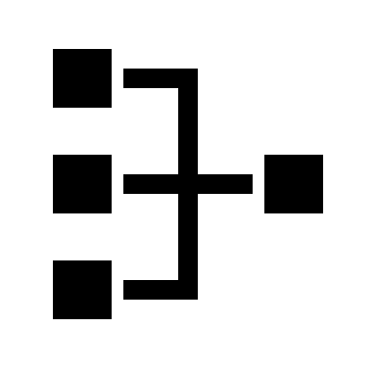



Contents
System Overall Block Diagram
--Basic Blocks & Attached Blocks
Non-linear System Analysis.
System Linearization.
--Steady State Analysis.
--Lateral Motion Control (Wash out Filter).
--System Discretization
Aerodynamic Analysis for Sonic Flight
--Model Aero-coefficient Analysis in XFLR5
--The CFD & FEA in ANSYS
Simulation
--Skidded to Turn in FlightGear.

Slide 14

Design Diagram
STATE EQUATIONS
MATLAB & Simulink
Nonlinear System Blocks
Trimmed System
ASW28 DATA
Discretized System
Linear System
CFD
Aerodynamic Analysis
SISO System
MIMO System
ANSYS & XFLR5
Aero
coefficients
FlightGear v3.0
Controller & Filter Design
Lateral Motion Control

Slide 15
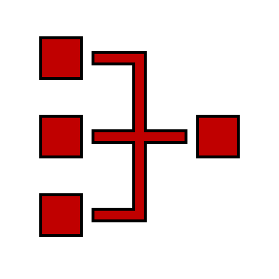
System Overall Block Diagram
Basic Control Blocks
Attached Control Blocks(AeroSurf & Propeller)

Slide 16
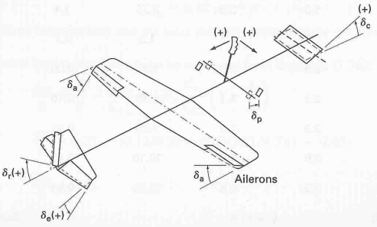
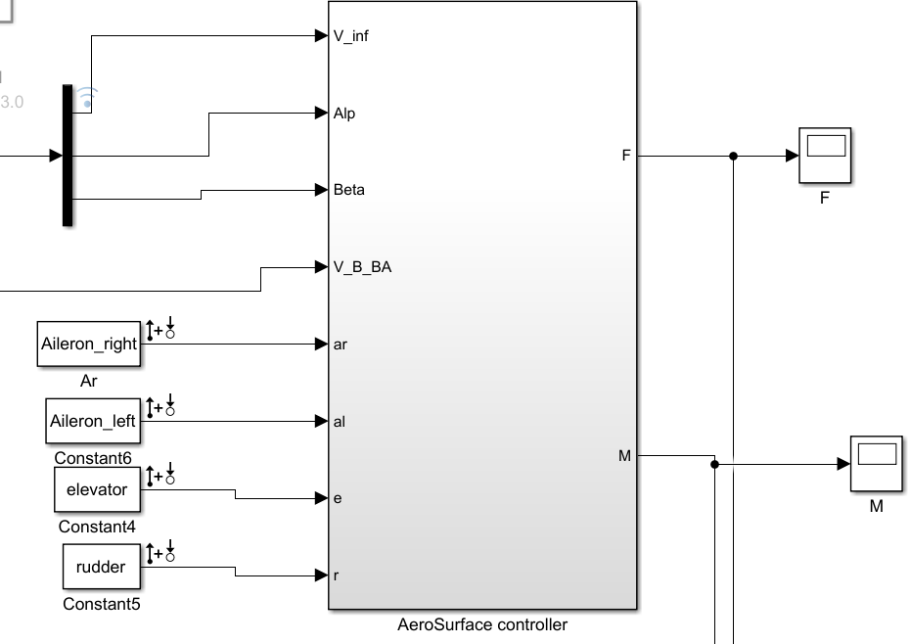
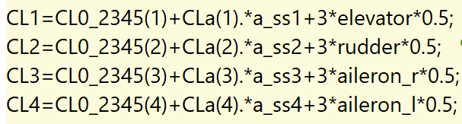
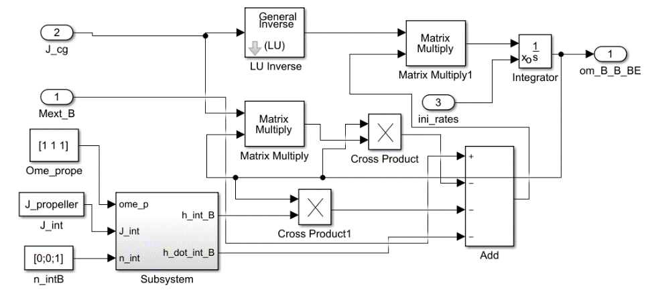
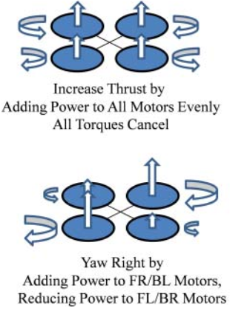
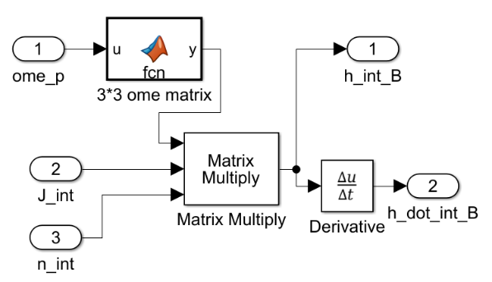
System Block Diagram
Basic Control Blocks
Translational Kinematics
Translational Dynamics
Rotational Kinematics
Rotational Dynamics
Propeller Control Diagram
Aero-Surface Control

Slide 17
Non-linear System
Trimmed Model
PID Controller Design for System Damping

Slide 18
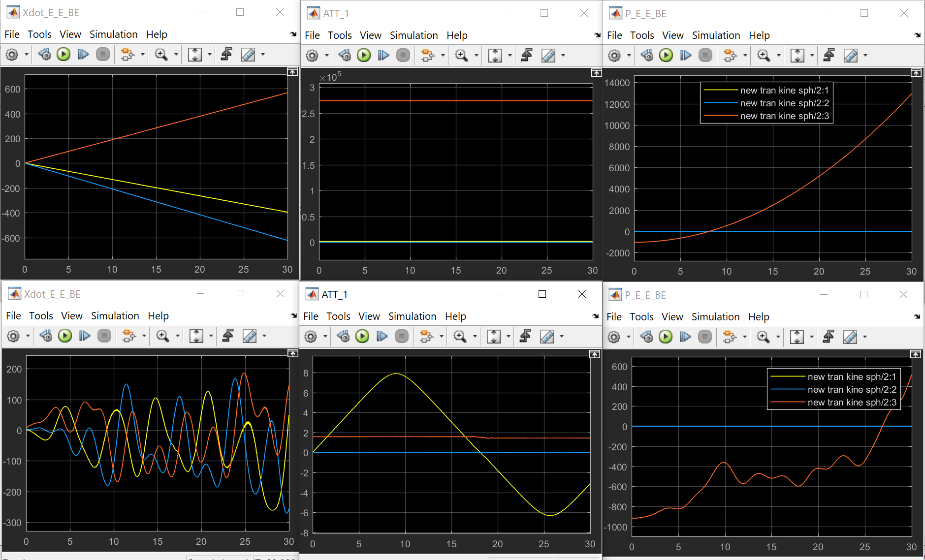
Model Trimming
Trimmed Model
Untrimmed Model
Trimmed States [Alt, Phi, Psi, V, P, Q, R]
Notes:
‘Linear Control Design’ in Simulink

Slide 19
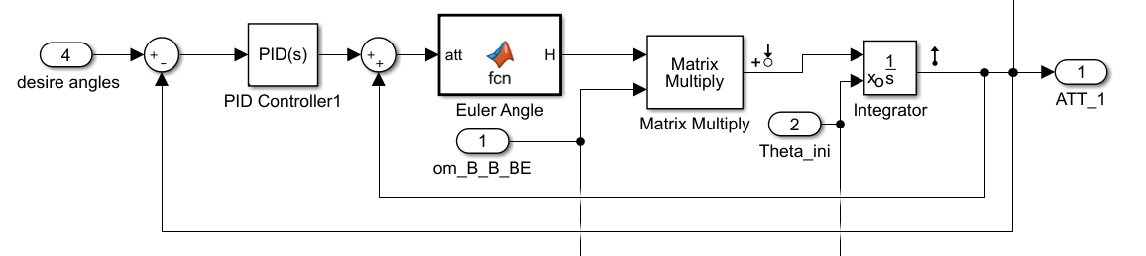
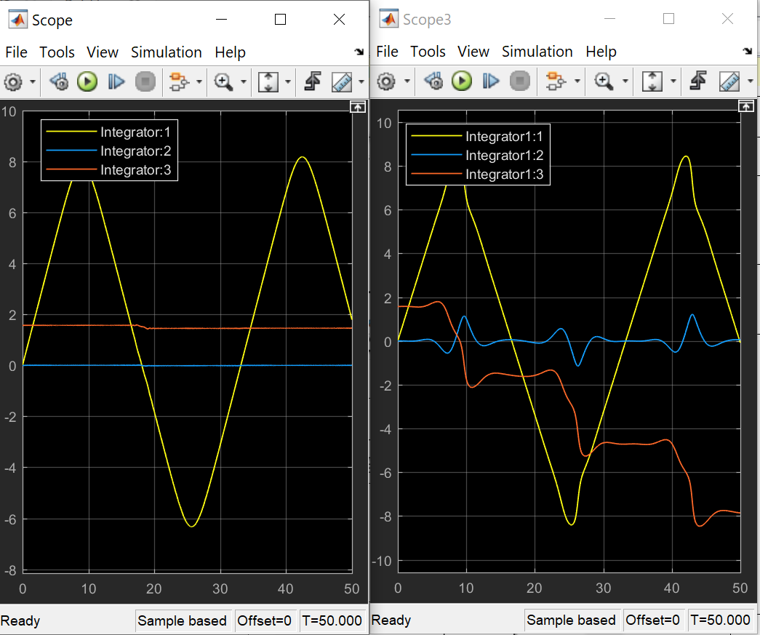
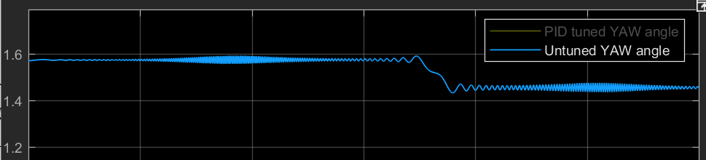
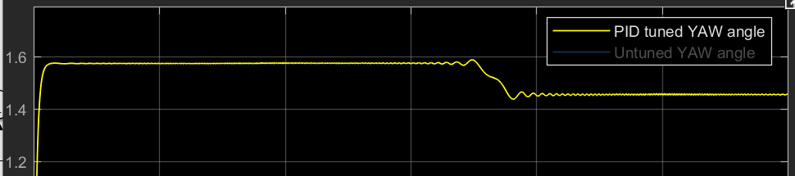
PID Controller Design for System Damping
With PID
Without PID
Yaw Angle Tuned
Notes:
PID design in the Nonlinear system rotational Kinematics works like a damper to reduce the system damping

Slide 20

System Linearization
Linearized System Behaviors & PID design
Steady State Analysis.
Lateral Motion Control (Wash out Filter).
System Discretization

Slide 21
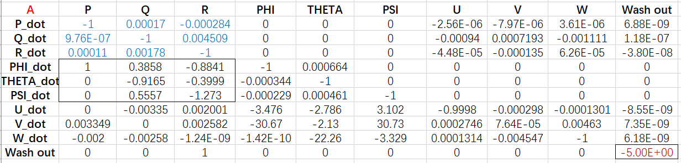
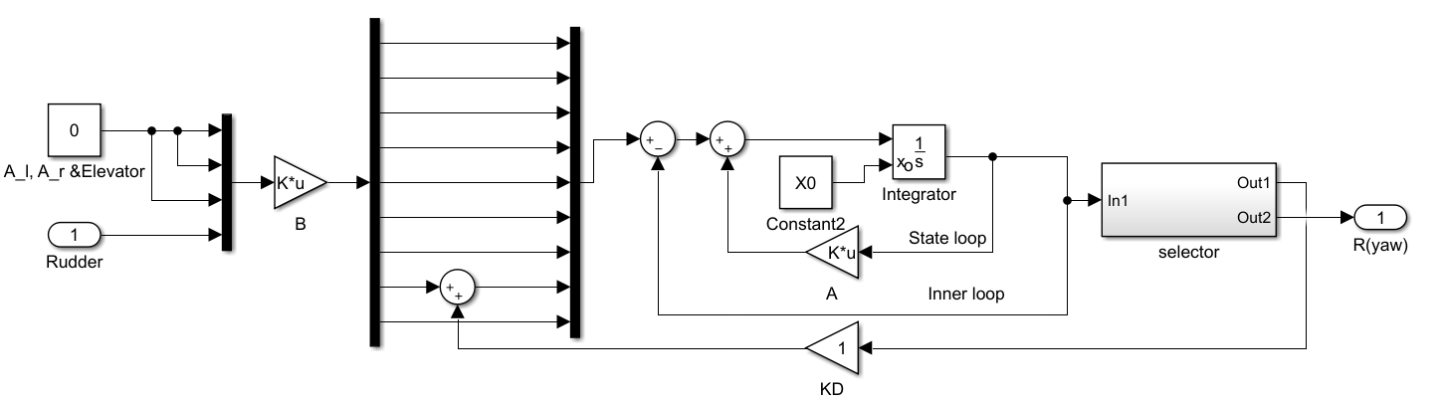
Model Linearization

Slide 22
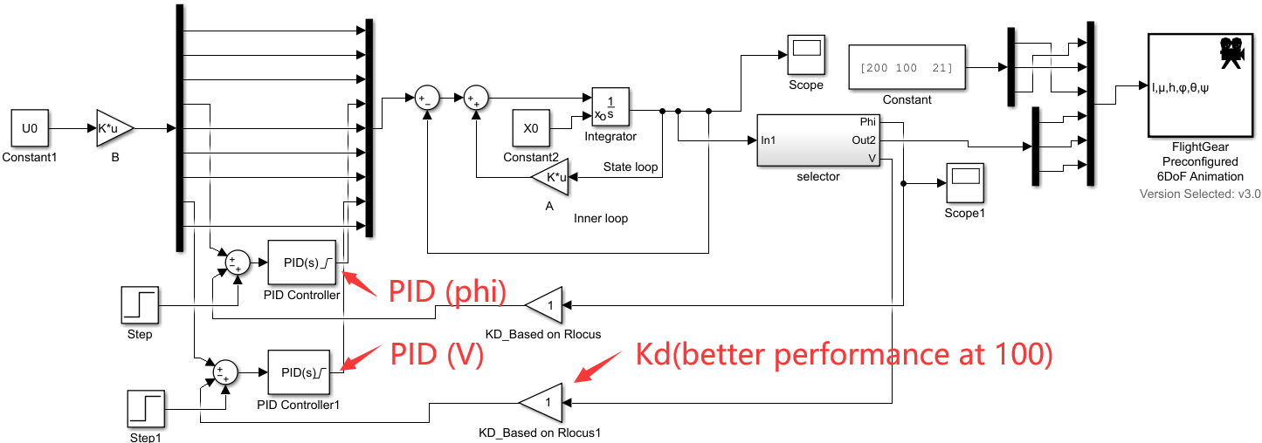
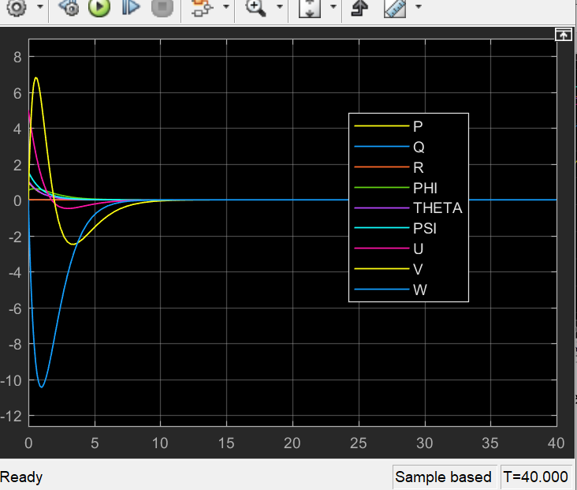
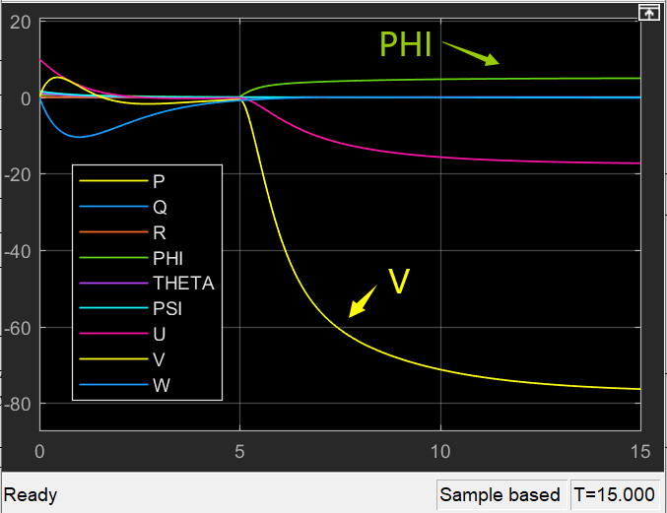
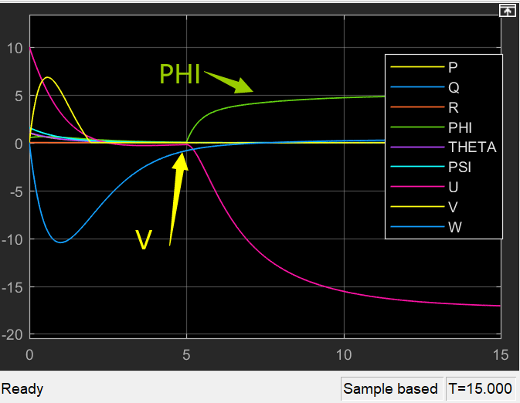
Linearized System Controller Design
No PID Applied
PID only applied to ‘phi’
PID applied to ‘phi’ &’V’

Slide 23
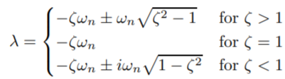
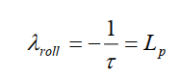
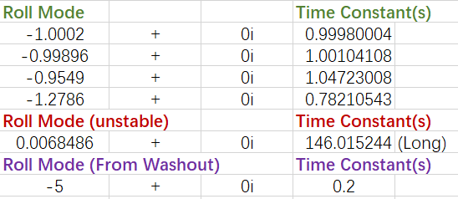
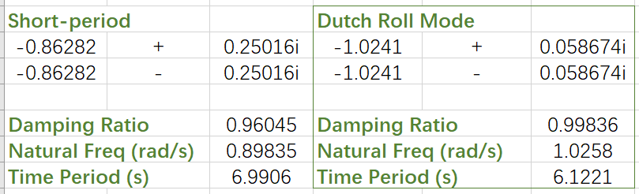
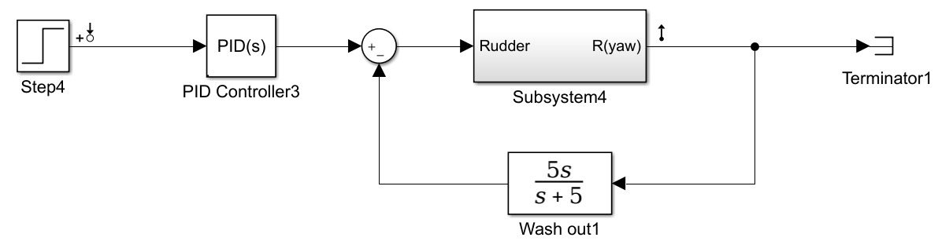
Steady State Analysis.
Oscillatory Mode
Stable Exponential Mode
HOW can I change these Dynamic Behaviors?
Notes:
From the Eigenvalue we could settle the following modes
The oscillatory mode for example the dutch roll mode
is a rolling and yawing motion with some side slipping which could affect the Lateral motion stability.
Also we have Fast response roll stable and relatively slower unstable roll mode on this model. To be noticed, the washout filter has one extra short roll mode to the model.

Slide 24
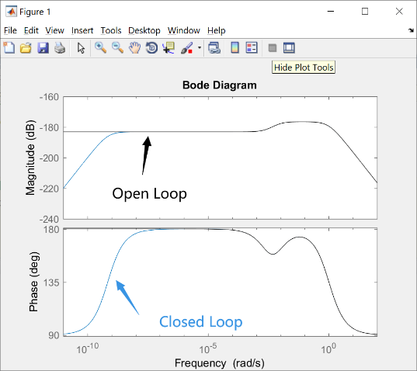
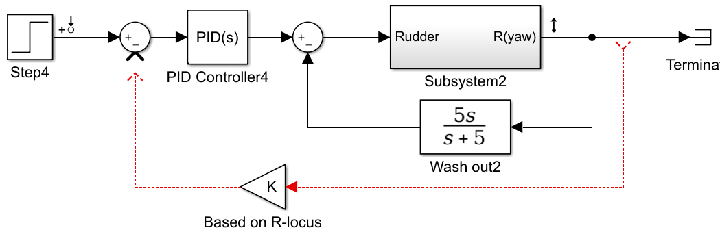
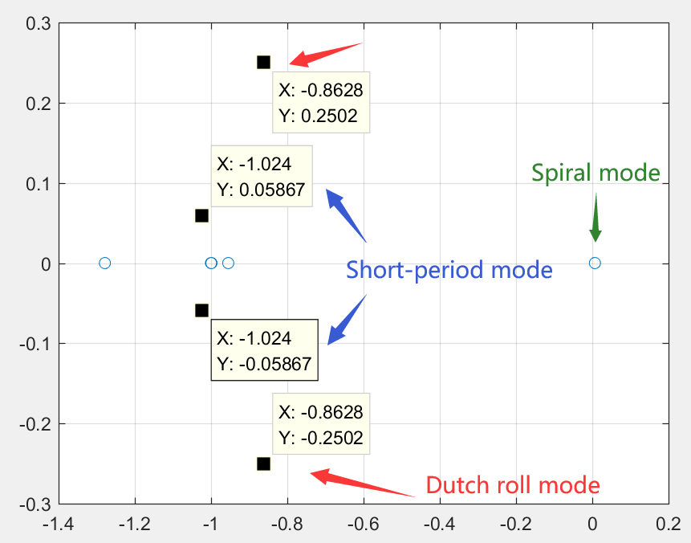

‘K’ Design Using R-locus
Bode in Freq Domain
Rlocus in Time Domain
Eigenvalue(A) Distribution
Notes:
From Eigivalue distribution and R-locus, we could see that the corresponds between each other.

Slide 25




Wash Out Filter
(a)
(b)
Washout Filter removes slowly-changing component and preserves the fast-changing component in INPUT
OUTPUT remains unchanged
(a)
(a)
(b)
Notes:
A washout filter simply removes any slowly-changing component of the input and preserves the fast-changing component, sometimes called "high-pass" behavior because high frequencies pass through. This is similar to (and can even be an approximation for) taking a derivative of the input: sudden changes produce a large output, slowly changing or constant values produce almost no output. Washout filters have a time-constant or cutoff frequency that determine where it draws the line between "fast" changes and "slow" changes. Most washout filters are very simple (generally first order) and, unlike many filters in signal processing, don't go to great lengths to get a sharp transition between signals that are passed and rejected.
the step response with noise shows an improvement during the initial transitory response. This is very important that even this little oscillation is damped out.

Slide 26










Discretized System
(Digital Control)
Figure-1 Discrete System
Figure-3 Signals
Signal: STEP & CHIRP
Sample time: 0.01s
Discrete Method: ZOH
Figure-2 Discrete VS Continuous
Notes:
For this part the linearized system including the input and PID are totally discretized. We can see the slight difference between discrete and continuous while the step time is so small and the magnitude of the input is large enough.

Slide 27

Aerodynamic Analysis
for Sonic Flight
FEA in ANSYS
CFD & Wind Tunnel Analysis in ANSYS
Aero-coefficient Comparison (Alpha=Beta=0[deg])

Slide 28




The Aerodynamic Analysis in ANSYS
Model Name | ASW28
Velocity(m/s) | 400
Temperature(ºF) | 77
Altitude(m) | 1000
Air Density(kg/m^3) | 1.074
Pressure Distribution
Finite Element Analysis(FEA)
Cephalic Cone

Slide 29




Wind Tunnel & CFD Analysis in ANSYS
Velocity Distribution
U-Velocity
V-Velocity
W-Velocity
Figure. Velocity Contour (left); [u; v; w] in Longitudinal Symmetry Plane

Slide 30




Aero-coefficient Comparison (Alpha=Beta=0[deg])
0.06277
Cl
0.000285
Cd
ANSYS (x-time, y-coefficient)
XFLR5
Notes:
Data in ANSYS need to be deductive by the area of wings. We could see the slightly different between ANSYS and XFLR5 model. Also we should know that the sonic flying air turbence could be so unstable. The result may not be so reliable.

Slide 31

Simulation
Pilot Control System
Skidded to Turn Simulation

Slide 32



Pilot Control Simulation
Autopilot Roll Angle Control Theorem
Pilot Control (with Time-delay & Disturbance)

Slide 33







MIMO System Control
No Signal Input
Large Signal Input
Motion Control

Slide 34






Skid to Turn
Skid to Turn angles
Skid to Turn Simulation

